Slide 1
When Is Polycentric Governance Sustainable?
Using Institutional Theory to Identify Endogenous Sources of Dysfunctional Dynamics
Michael D. McGinnis,
Senior Research Fellow, Ostrom Workshop, & Professor Emeritus of Political Science,
Indiana University, Bloomington, mcginnis@Indiana.edu
Elizabeth B. Baldwin,
Assistant Professor, School of Government & Public Policy,
University of Arizona, Tucson, AZ, USA
Andreas Thiel,
Professor, International Agricultural Policy and Environmental Governance,
University of Kassel, Germany
Prepared for The Ostrom Workshop Monday Noon Colloquium Zoom Session, Sept. 14, 2020

Slide 2
Classic Definitions of Polycentric Governance (PG)
“The traditional pattern of government in a metropolitan area with its multiplicity of political jurisdictions may more appropriately be conceived as a ‘polycentric political system’. ‘Polycentric’ connotes many centers of decision-making which are formally independent of each other. Whether they actually function independently, or instead constitute an interdependent system of relations, is an empirical question in particular cases.” (OTW 1961, 831, bolding added)
“A polycentric organization has been defined as a pattern of organization where many independent elements are capable of mutual adjustment for ordering their relationships with one another within a general system of rules.” (V. Ostrom 1972, in McGinnis 1999, 73; bolding added)
“By ‘polycentric’ I mean a system where citizens are able to organize not just one but multiple governing authorities, as well as private arrangements, at different scales.” (E. Ostrom 2003, in Cole and McGinnis, eds., 2015, 61 bolding added)

Slide 3
Preliminary Findings from Literature Review
Scholarly interest in polycentricity is burgeoning & broadening
Studies acknowledge challenges, esp coordination and capacity
Most applications descriptive or policy advocacy, rarely used as explanatory factor
  We’d like to see empirical propositions grounded in theory
Very few studies examine dynamics or evolution of PG systems,
  We see endogenous dynamics of self-organization as a key missing element, to complement existing studies of adaptation to shocks
We identify negative syndromes that may emerge endogenously
  and suggest ways policy actors may counteract these trends towards dysfunctionality.

Slide 4
Other Names for PG-Type Systems of Governance
Adaptive governance (Polanyi 1951, Folke et al. 2005, DeCaro et al. 2017)
Multi-level governance (Hooghe & Marks 2001, 2003)
FOCJ (Functional Overlapping Competing Jurisdictions) (Frey & Eichenberg 1996, 2004)
Collaborative governance (Bryson, Crosby, and Stone 2006, Ansell & Gash 2007, Emerson, Kirk, and Nabatchi 2015)
Cross-sector network governance (Feiock 2009, 2013, Swann & Kim 2018)
Marble-cake federalism (Grodzins 1960, Bohte & Meier 2000)
Regime clusters (Young 2002, Epstein et al. 2014, Blondin & Boin 2020)
Nexus governance (Villamayor-Tomas et al. 2015, de Loë & Patterson 2018)

Slide 5
Claimed Benefits of PG
Effective production and provision of diverse public goods (OTW 1961)
Existence Proof of local capacity for self-governance (E. Ostrom 1990)
Resilience of emergent order (Polanyi, complex systems theory)
Adaptable response to exogenous shocks (especially in SES analyses)
Generation and sustainability of rules for resource use consistent with local conditions and locally grounded knowledge (E. Ostrom 1990)
Building and reinforcing an overarching system of law, rules, and shared values built on widespread norms of trust and reciprocity (VO, EO)
Balance between personal freedom and collective authority over public goods (V. Ostrom 2008a,b, Aligica 2014, Aligica, Boettke and Tarko 2019)
Widespread public entrepreneurship (VO 1988, EO 1965, 2006, Aligica 2019)

Slide 6
Dimensions of Polycentric Governance
Structural Characteristics* | Dynamic Processes* | Outcomes*
1. Multiple decision centers (of varying sizes and types); 2. De jure independence or de facto autonomy of decision-making authority for decision centers; 3. Overlapping jurisdictions in the range of authority; | 4. Multiple processes of mutual adjustment among decision centers (taking each other into account); 5. Low entry and exit costs for organizations or informal groupings; | 6. Within an overarching system of rules (or laws, norms, and shared values); 7. Emergent patterns of behavior, interactions and outcomes across decision centers (emergent order); 8. Emergent and intentional means of effective coordination at all levels of aggregation, incl. system as a whole. (not always included in definition)
Adapted from Stephen et al., in Thiel, et al., eds., Governing Complexity, (2019: 41)
*Note: These terms weren’t used in original, because some dimensions belong in more than one category.
Feedback from outcomes to both structure and processes are critical determinants of sustainability.
Some outcomes will reinforce current structure and processes, or help in adjustment to changing environment, but other outcomes may undermine the system’s current operation or ability to cope with exogenous shocks.

Slide 7
Steps in Self-Organizing – THE Key Process of PG
Identifying others with similar interests or concerns on selected issues (even if they differ on other matters)
Locating (or constructing) a place (or other mode of communication) where deliberation via respectful contestation can occur
Agreeing upon what behaviors are acceptable within that forum or mode of communication (defining rules of the game)
Identifying & evaluating options for appropriate means towards shared goals, including decisions to seek external assistance
Surveying the existing institutional landscape to locate & contact public officials or professional experts with access to relevant resources or information
Analyzing the quality of information or assistance from external parties, and its relevance to core concerns of group
Making collective decisions within the group, through voting or some other form of mutual adjustment,
Coordinating with external assistants or agents of other decision units willing to work together on common goals
Implementing a collective decision, even if it has negative effects on reluctant members of a decision unit
Monitoring to identify individuals or organizational agents whose behavior deviates from group norms or expectations, and to share that information with other interested parties
Ensuring external assistants (or agents) still respect the values & interests of the core group
Selecting and applying appropriate sanctions on norm violators or disappointing (especially if duplicitous) agents in ways that might encourage them to correct their misbehavior and improve their performance
Reconsidering & revising group membership, goals, practices, and agents to realign with core group values and goals
Identifying & integrating sources of funding for any and all of these endeavors
Repeat (and cycle back to any previous step) as needed.

Slide 8
PG as an Infrastructure for Resources for Collective Action
Dimensions of PG
Support & Sustain
Resources for Self-Organization
Multiple decision centers
Semi-autonomous decision centers;
Overlapping jurisdictions
Multiple processes of Mutual Adjustment
Low entry, exit, and constitutional costs
Overarching system of values, norms, rules
Emergent order
Means for effective coordination at all levels (not required by all authors)
Individuals with a diversity of values, knowledge, capabilities, & interests
Multiple sources of information and advice
Easy availability of decision forums
Shared norms of respectful contestation (within agreed-upon “rules of a game”
Repertoire of organizational forms and rule configurations -- Institutional diversity
Access to mechanisms to resolve conflicts
Some authorities can enforce agreements
Shared values and modes of thought
Shared traditions and experiences

Slide 9
What Could Go Wrong? – Insights from Institutional Theories
Transaction costs of self-organizing processes will always vary across groups
Negative externalities of self-org. may be neglected, but they do change distribution of transaction costs! – and create power asymmetries
Biases against “others” can be used to gain support for collective action
Effects of collective decisions accumulate over time (path dependence)
Access to other actors/resources critical to cope with power asymmetries
  Note: many existing authorities were generated through past self-organization
With public authority comes opportunities for opportunism (ex: rent-seeking)
Rules of game (respectful contestation, compromise/mutual adjustment, professional ethics) are often broken for strategic reasons,
  Doing so too often can undermine shared understandings that support those games and transform them into struggles for domination

Slide 10
Table 1. Syndromes of Dysfunctional PG Dynamics
Triggering Tendency or Temptation | Mode of Accumulation | … | Equilibrium Trap | PG Syndrome
Smaller and short-term changes mean lower transaction costs; and lower negative externalities | Successful groups protect their gains & concentrate on short-term gains; inequities & vulnerabilities accumulate | … | Veto players proliferate and immobilize system, now vulnerable to major crises & pent-up pressures from slow drivers | Incrementalism and Scale Mismatches
Partisanship can simplify complex issues to public and facilitate elite coordination in campaigns and governance | Partisanship can become emotional group marker, inducing rapid escalation of even minor disputes | … | Public officials avoid compromise, resulting in gridlock and erosion of shared values & public trust; public service no longer seen as an honorable profession | Symbolic Politics and Hyper- Partisanship
Common biases against “others” help support collective action targeted against them (or affecting them indirectly) | Serial “victims” of dominant groups’ self-organization become profoundly marginalized | … | Racial or other inequality becomes widely accepted as natural, and as a valid basis for resisting reforms | Exclusion and Institutionalized Inequalities
Regulatory authority allows possibility of awarding special privileges to some groups | Regulatory capture by special interests is allowed by officials eager for gain | … | Pervasive corruption poisons political process; frequent scandals rarely result in real reform | Rent-Seeking and Pervasive Corruption
Easy to delegate to others (esp. political leaders) responsibility for addressing big problems | Incentives to accumulate the power needed to match public’s expectations | … | Political officials act imprudently, justify goals after the fact, and hide information from public | Over-Centralized & Authoritarian Rule
Public officials often eager to delegate details of program implementation to experts | Officials’ primary desire for cost savings may lead to low oversight of private partners | … | Public policy outcomes do not cohere to a normative vision for society, | Hollowed-Out Collaborative Governance

Slide 11
Countervailing Forces in PG Syndromes (1)
Incrementalism and Scale Mismatches | Natural Accumulation of Tendencies & Temptations | Proactive Maintenance of Polycentric Governance
Citizens & Self-Organized Groups | Complacency, reluctance to undertake direct action or make difficult changes to everyday activities | Participate in direct political action, mobilize to insist on needed change, protect interests of future generations
Political Leaders & Public Officials | Veto players jealously protect current position and downplay future concerns | Act as good stewards of society’s resources, try to insure long-term security and sustainability
Private Organizations & Professional Associations | Markets reward short-term earnings; Media cater to prejudices of audience rather than fair analyses; Scientists avoid direct involvement in policy | Corporations incorporate social responsibility goals into strategies; Media disseminate balanced analyses; Scientists publicize long-term consequences of current policies

Slide 12
Next Steps:
Translate countervailing forces into empirical indicators
  Focus on warning signs, or ways particular types of actors could help?
Develop theory to connect syndromes to performance measures
  Unlikely to be simple relationships, balance of creative tension
    Cross-stream spillover or reinforcement of countervailing forces
Develop theory of strategic guidance (i.e., governance) in PG
  Recognize close interplay of bottom-up and top-down processes
  “Give the governance part of PG equal billing with its polycentricity”

Slide 13
Additional Slides

Slide 14
Warning Signs of Impending Dysfunctionalities
Incrementalism and Scale Mismatches | Increase in number of veto points in getting new policies enacted and implemented; Increase in complexity of application procedures for public assistance programs Increasing frequency of previously rare events, such as extreme weather or migration surges Decreasing accuracy of budget projections included in policy proposals or implemented programs
Symbolic Politics and Hyper-Partisanship | Increase in stridency of rhetoric in policy debates, Increase in party consistency in roll call votes, Decrease in number or frequency of policy forums where experts from different policy domains discuss concerns
Exclusion and Institutionalized Inequalities | Measures of bias in effects of programs on recipients from different social groups, Increased efforts at voter suppression of minority groups, Increases in aggregate measures of income or wealth inequality or Decline in inter-generational mobility by income or class rank
Rent-Seeking and Pervasive Corruption | Increase in lobbyist participation in drafting laws or regulations, or in support briefs in legal cases, Increase in campaign contributions by special interest groups, Increases in aggregate measures of economic resources “wasted” in rent-seeking related activities
Over-Centralized and Authoritarian Rule | Increased dependence of state and local agencies on funds provided by the central government; Increase in intrusiveness of laws or regulations on personal or corporate behavior, Increase in number of Freedom of Information act requests denied by courts or ignored by officials,
Hollowed-Out or Technocratic Governance | Higher proportion of technical experts in Congressional hearings or court cases; Increased role of professional associations in standard-setting; Absence of measures taken to insure public access to information on implementation of policies, Fewer channels to challenge actions of private partners in policy design or implementation

Slide 15
Other Efforts to measure PG and its performance
Aligicia and Tarko, 2012: logical structure of PG varieties, but no dynamics
Carilse and Gruby, 2017: Enabling conditions between structure & performance, but no explanation of how the enabling conditions are enabled or sustained
van Zeben and Bobić 2019 includes justice and democratic deficit as EU concerns
Jordan et al. 2018, emphasize variation in descriptive and normative concerns in global climate studies based on complex governance
Thiel et al. 2018 covers range of policy settings, calls for more rigorous comparisons
Network models/ecology of games (Lubell 2013, Lubell et al. 2010, 2014, Berado & Lubell 2019)
  Network-based measures of number of actors, or decision arenas, or diversity of actors in arenas (by sector),
  Useful but limiting, because institutions are more than network connections, and critical PG institutions are hybrid forms combining private, public, and professional functions
State-reinforced self-governance, Sarker 2013, DeCaro et al. 2017

Slide 16
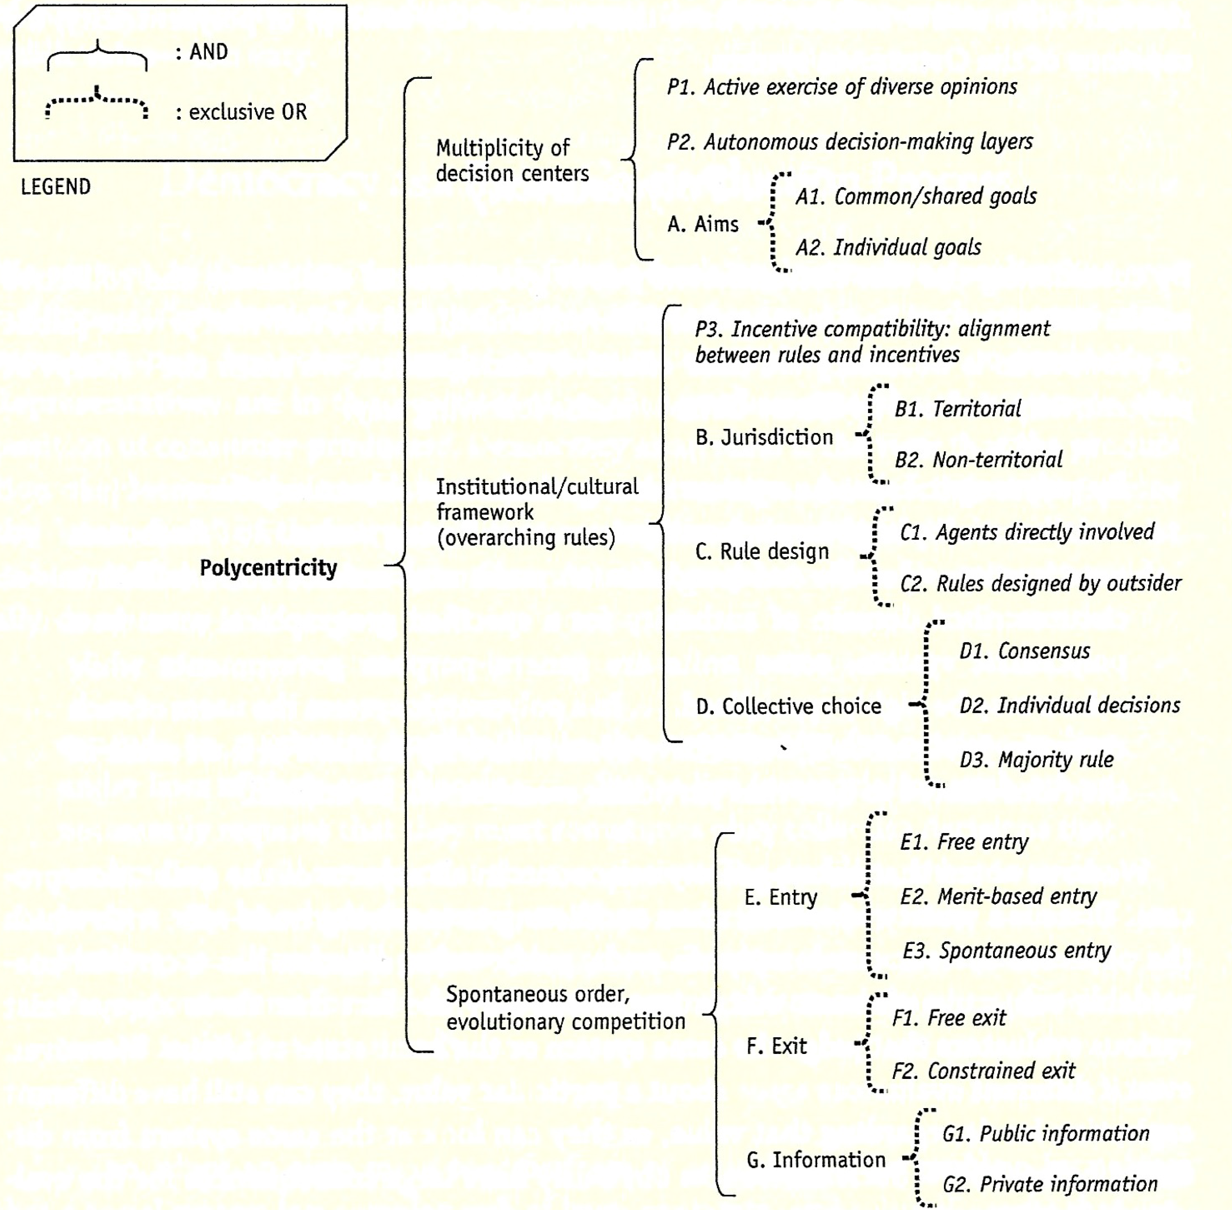
Aligica & Tarko nested logical structure of PG varieties
(Aligica et al. 2019:146)

Slide 17
Carilse and Gruby 2017
Attributes | Enabling Conditions | Advantages:
Multiple overlapping decision-making centers with some autonomy | Employ diverse institutions Exist at different levels and across jurisdictions Jurisdiction coterminous with problem boundaries | Enhanced adaptive capacity Good institutional fit Risk Mitigation / Redundancy
Choose to take account of others through cooperation, competition, conflict, and conflict resolution | Applicable rules and norms structure actions & behaviors Participation in cross-scale linkages and other mechanisms for learning Mechanisms for accountability Variety of formal and informal mechanisms for dispute resolution

Slide 18
van Zeben and Bobić 2019,
Polycentricity in the EU

Slide 19
Jordan et al. 2019

Slide 20
Jordan et al. 2019

Slide 21
Transaction Costs of Self-Organizing
Search costs of identifying potential allies or others with similar interests or concerns
Forum search (entry) costs of locating a place (or communication mode) for respectful contestation
Constitutional choice costs for arranging for a new forum or means of conducting deliberations
Discussion costs to agree upon what behaviors are acceptable within that forum (rules of the game)
Search and analytic costs of identifying & evaluating appropriate means towards shared goals, including potential appeals for external assistance
Evaluation costs to determine quality and relevance of information from external assistants
Deliberation costs required for making collective decisions, through processes of mutual adjustment
Coordination costs involved in mutual adjustments with agents of other units (external)
Authority costs of implementing a collective decision on reluctant members of that unit
Monitoring costs to identify members or agents who deviate from group norms or expectations, and to share that information with other interested parties
Accountability costs to ensure agents still respect the values & interests of the core gropu
Sanctioning costs to select and implement formal or informal sanctions on norm violators
Reformability costs to facilitate revisions to existing practices to realign with relevant societal norms
Provisioning costs of identifying and integrating sources of funding for these endeavors
Exit costs to remove oneself from the authority of specific decision units

Slide 22
What Could Go Wrong? – Insights from Lin*
Some appropriators will not organize
Some self-organized efforts will fail
Local tyrannies
Stagnation
Inappropriate discrimination
Limited access to scientific information
Conflict among appropriators
Inability to cope with larger-scale common-pool resources
Rapid endogenous changes
Transmission failures from one generation to the next
Programs relying on blueprint thinking and easy access to external funds
Corruption and other forms of opportunistic behavior (rent-seeking)
Lack of large-scale (supportive institutions) institutional arrangements related to
  reliable information collection, aggregation and dissemination;
  fair and low cost conflict-resolution mechanisms;
  educational and extension facilities; and
  facilities for helping when natural disasters or other major problems occur at a local level.
[*E. Ostrom 2005: 282-3, 272-9, on limits of fully decentralized system of resource governance]

Slide 23
Countervailing Forces in PG Syndromes (2)
Symbolic Politics and Hyper-Partisanship | Natural Accumulation of Tendencies & Temptations | Proactive Maintenance of Polycentric Governance
Citizens & Self-Organized Groups | Emotional identification with political party, refuse to listen to arguments made by those from the “other” side | Respectfully engage with advocates from “the other side,” acknowledge and reinforce common civic values
Political Leaders & Public Officials | Cater to party extremists, avoid practical compromises, sacrifice common good for partisan advantage | Acknowledge that politics requires compromises, demonstrate their commitment to public service; resist insistent demands of party extremists when needed
Private Organizations & Professional Associations | Scientists and media shape policy advocacy, science, and news coverage to support partisan positions | Demand that political leaders respect scientific findings, refuse to be co-opted by funding agencies or ideologies

Slide 24
Countervailing Forces in PG Syndromes (3)
Exclusion & Institutionalized Inequalities | Natural Accumulation of Tendencies & Temptations | Proactive Maintenance of Polycentric Governance
Citizens & Self-Organized Groups | Reluctance to consider the potential harm of their own actions on others, especially minority groups | Insist on protection of minority rights; seek information on the harm done on others by their own actions
Political Leaders & Public Officials | Write & enforce laws treating social groups differently, reinforce negative images of disadvantaged groups | Facilitate efforts by disadvantaged groups to protect their interests, insist laws treat social groups equally, resist negative images of minorities
Private Organizations & Professional Associations | Media & scientists frame news and research findings to reinforce social prejudices; Resist efforts to increase social diversity within their profession; | Moral entrepreneurs: mobilize for reforms that treat all groups equally

Slide 25
Countervailing Forces in PG Syndromes (4)
Rent-Seeking & Pervasive Corruption | Natural Accumulation of Tendencies & Temptations | Proactive Maintenance of Polycentric Governance
Citizens & Self-Organized Groups | Focus on political issues with direct impact on their own situation, even if programs waste society’s resources | Recognize particularistic benefits (farm subsidies, etc.) can have detrimental effects on society as a whole
Political Leaders & Public Officials | Use policy details to reward special interest groups willing to provide campaign support to them | Protect and encourage whistle-blowers who reveal corrupt or inappropriate deals with private actors
Private Organizations & Professional Associations | Engage with public officials to “capture” (or co-opt) the making and enforcement of all laws and regulations affecting their profession | Acknowledge tradeoffs required when a policy domain has important effects on other parts of society

Slide 26
Countervailing Forces in PG Syndromes (5)
Over-Centralized and Authoritarian Rule | Natural Accumulation of Tendencies & Temptations | Proactive Maintenance of Polycentric Governance
Citizens & Self-Organized Groups | Easy to let others take care of politics, and to raise expectations for more benefits from programs | Demand continued rights of freedom of expression and access to information on public officials
Political Leaders & Public Officials | Follow incentives to accumulate power needed to meet public expectations, and hide as much information as possible | Respect constitutional controls on exercise of power and
Private Organizations & Professional Associations | Prefer stability and predictability of laws and regulations, wiling to let political leaders hide information from public | Emphasize their willingness to let public know details about their activities,

Slide 27
Countervailing Forces in PG Syndromes (6)
Hollowed Out or Technocratic Gov. | Natural Accumulation of Tendencies & Temptations | Proactive Maintenance of Polycentric Governance
Citizens & Self-Organized Groups | Defer to experts on technical questions, eagerly adopt new tech and accept its social consequences Ignore politics as much as possible and take full advantage of public programs as currently operating; reward elected representatives for “bringing pork” back home Support public officials who allow private parties to determine policy & don’t even try to hold either group accountable Focus on single-issue politics, don’t consider consequences on other issues, avoid potential compromises | Insist that tech companies are responsible corporate citizens that respect privacy and other social concerns Stand up for their values when they are neglected or undermined by public officials Hold public officials accountable for actions of the private actors to whom they delegate authority, and insist that results serve the public interest Look beyond narrow interests to consider what’s needed for society as a whole
Political Leaders & Public Officials | Defer to technical experts and avoid dealing with genuine conflicts generated by different technologies Delegate more and more public authority to private partners in governance, and protect them from public scrutiny; evaluate performance on realizing cost savings, no matter how poor the outcomes otherwise Avoid confronting really tough, big problems that require coordination of diverse & powerful interests | Support research and development of new technical capacities to better serve the public interest Maintain close supervision of all private partners engaged in policy implementation, and publicize any resulting scandals Articulate the “vision thing” to the public, to put specific controversies in a broader social context
Private Organizations & Professional Associations | Follow professional norms, no matter how far removed from widely shared social norms and values Partner with public officials and use expertise to implement policies that serve their profession’s interests Epistemic communities in separate professions govern themselves and ignore consequences on society | Acknowledge how much their products effect environmental conditions and social interactions Approach questions of technological impact on society from a humble perspective, and listen to others’ views Resist temptation to take advantage of their delegated positions of public authority, provide service to the public as good as they do their most valued customers Engage in cross-disciplinary research and management teams in order to broaden their horizons

